Slide 1
Requirements Gathering Form Overview

Slide 2
Naveen kumar (c0765772)

Slide 3
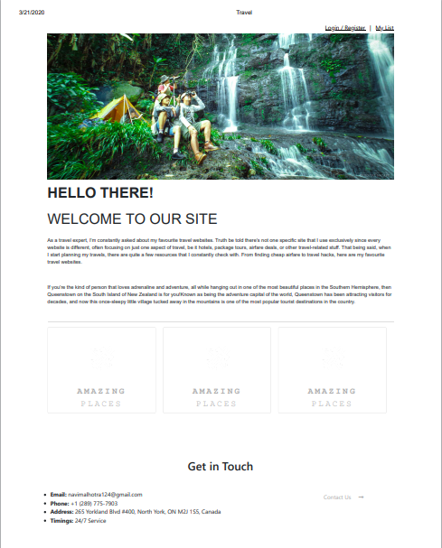
Website Objective
Travel Juneau
website is primarily focused on professionals in the agency travel services. We have reviewed the current website to make it more attractive and objective to customers.

Slide 4
1. Objectives

Slide 5
Provide a modern responsible website design that works both on mobile and desktop.
Improve the website navigation areas.
Provide more realistic photos options from different places.
Improve users experience to motivate user to contact the business via phone or form contact.
Increase online sales generating more profits for the agency.

Slide 6
2. Features and functionalities

Slide 7
Home Services About us Contact

Slide 8
3. Deliverable

Slide 9
Responsible for the basis of the project( Header and footer ) and the Home page. Responsible for developing the About us and contact Responsible for developing the Services , booking hotels , booking flights.

Slide 10
4. Development schedule
Our our release forecast is approximately 2 weeks after project approval.

Slide 11
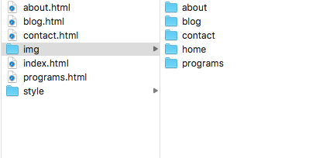
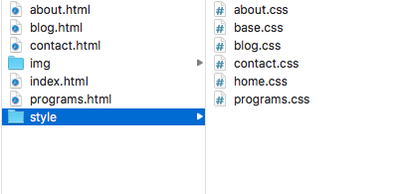
5. Structure
The deliverable structure of the website will follow the model bellow and also will be published this way:

Slide 12
WEB DESIGN
Bring the attention of your user over a key concept using pictures or illustrations

Slide 13
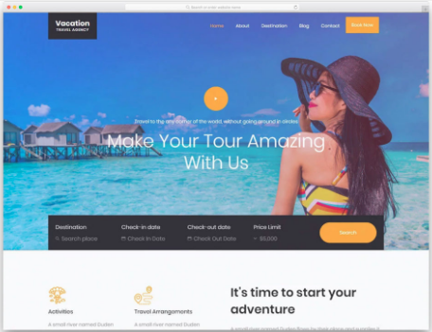
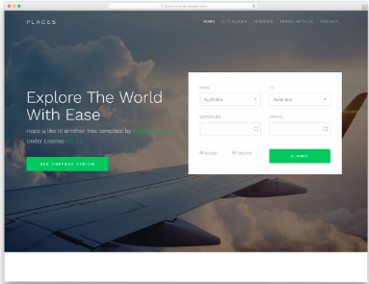
REVIEW DESIGN EXAMPLES
Many searches were made based on other competitive travel agency online

Slide 14

LOGO
The Logo was redefined

Slide 15
COLOR SCHEME
The colors were thought to remember diferente places from metropolis to desert places.
Black
Gray
Orange
Green
Blue

Slide 16
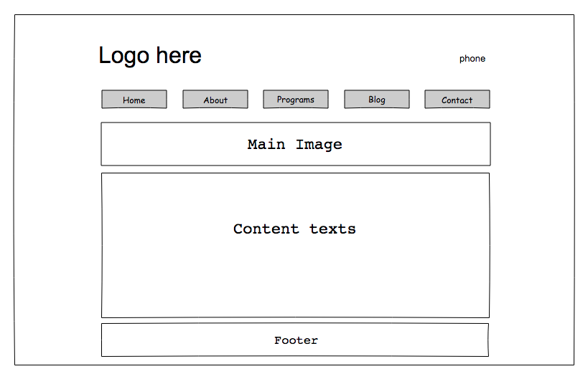
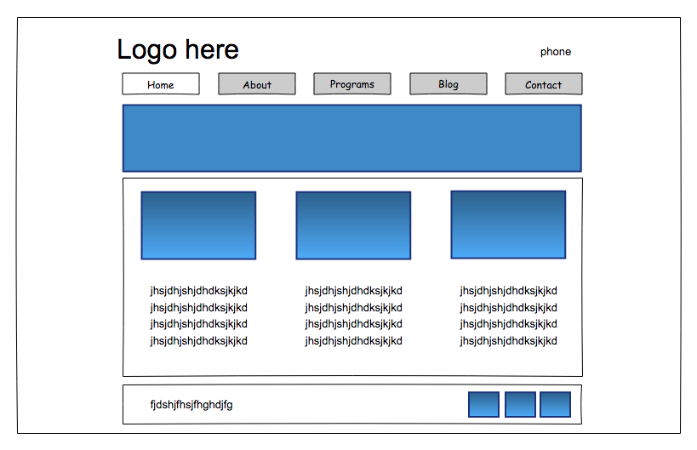
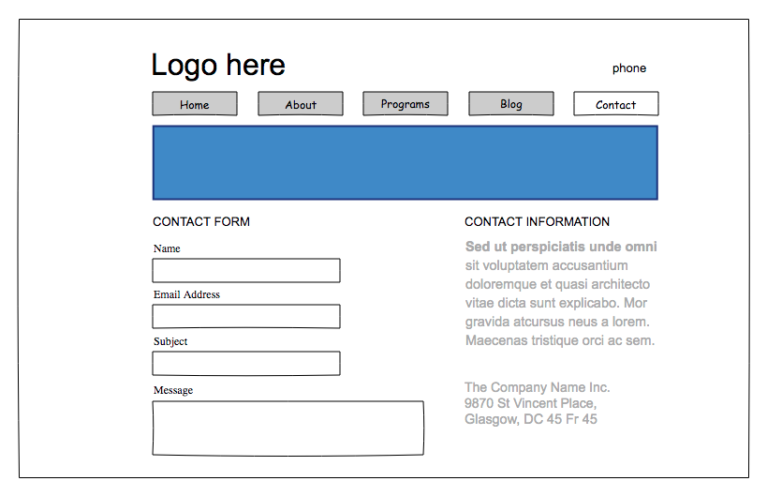
Mockups
What we think of developing

Slide 17
Mockups

Slide 18
Mockups

Slide 19
Mockups

Slide 20
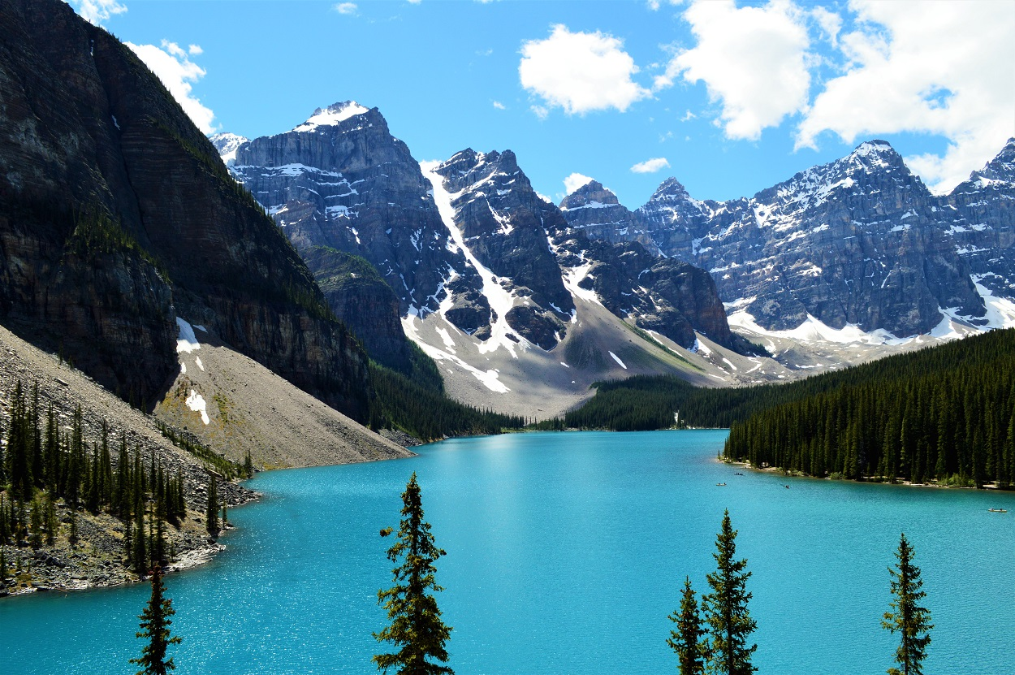
A PICTURE WORTH MORE THAN A THOUSAND WORDS

Slide 21

All images on the website will be real high definition photos of perfect places for a trip, these photos will be made available in large size so that the user can clearly appreciate the destination to be chosen.

Slide 22
MENU
The menu will be developed simply but effectively following the template below.
HOME
SERVICES
ABOUT US
CONTACT

Slide 23
WEB MAINTENANCE AGREEMENT
What is included in this agreement:
Graphics & photograph updates
Website Content Updates
What is NOT included in the agreement:
Web site redesign, re-alignment or re-development
Website Marketing

Slide 24
MAINTENANCE DELIVERABLES
Web page updates
Training
Additional Services

Slide 25
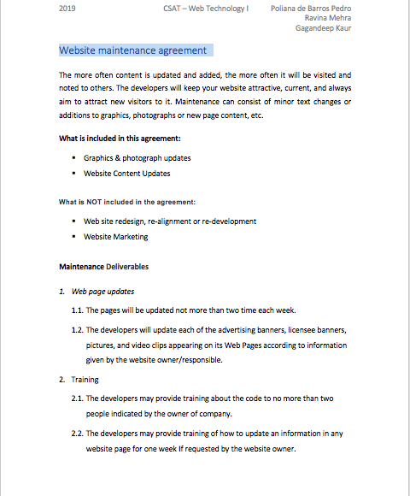
The document

Slide 26
THANKS!

